Slide 1
Java tools (Maven)
Tapti Palit

Slide 2
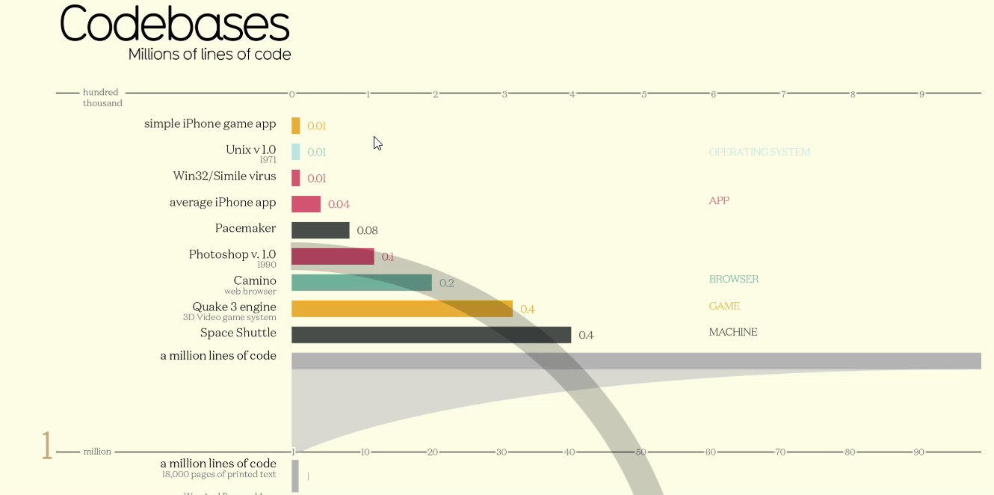
Size and complexity of software
Link: https://informationisbeautiful.net/visualizations/million-lines-of-code/

Slide 3
How to manage complexity?
Hard to remember exact class and method names
Need smart code completion
Need to know which code affected on renaming a class or method
Need code refactoring support
Often use external tools for version control, debugging, performance analysis, and so on
Need an Integrated Development Environment (IDE)
Notes:
- uniformity

Slide 4


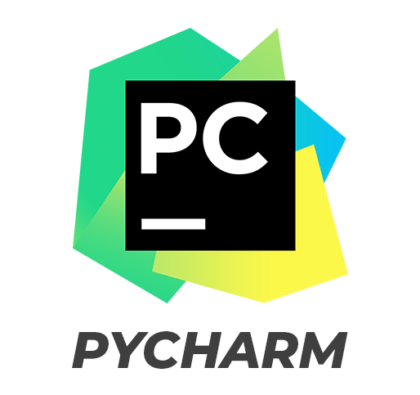


Popular IDEs

Slide 5
IntelliJ Demo
We will use IntelliJ for our assignments
Demo:
Creating new project
Version control using Git
Search
Running and debugging project
Refactoring
Plugins using Marketplace
Notes:
- Shift twice

Slide 6
Review: java compilation process
Java source file is compiled using javac into bytecode (.class)
Java bytecode (.class) is loaded into the interpreter which starts execution
During interpretation parts of bytecode compiled using Just-in-time compilation (JIT)
MyClass.java
javac compiler
Compile time
MyClass.class
Runtime
java interpreter
JIT compiler

Slide 7
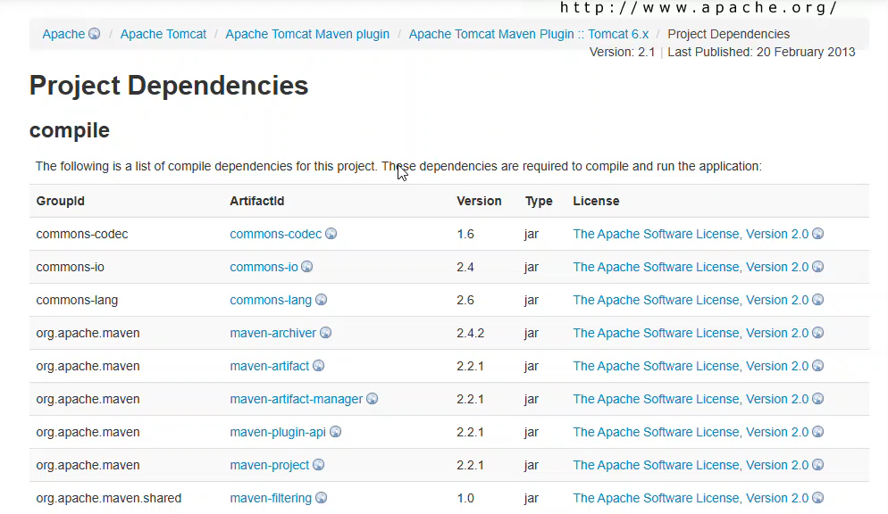
External library dependencies
https://tomcat.apache.org/maven-plugin-2.1/tomcat6-maven-plugin/dependencies.html

Slide 8
JAR file (Java archive)
Stands for Java ARchive
A compressed file format (like ZIP) that bundles multiple .class files, libraries, images, and metadata into one file
Simplifies packaging and deployment
Can distribute both libraries and executables as JARs

Slide 9
How to manage third-party library dependencies?
Libraries (and applications) are packaged as JAR (Java archive) files
A JAR archive consists of multiple .class files
javac YourClass.java
Create a text file named MANIFEST.MF
Manifest-Version: 1.0 Main-Class: YourClass
Use the jar command
jar cvfm YourApp.jar MANIFEST.MF *.class
Run the JAR file
java -jar YourApp.jar
Notes:
- Skip the MANIFEST.MF in order to create a jar for a library

Slide 10
How to manage third-party library dependencies?
Add needed JAR files to classpath
javac -cp .:path/to/your.jar YourProgram.java
java -cp .:path/to/your.jar YourProgram
Verbose, error-prone, non-reproducable (you use library version 1.0.2, another developer uses version 1.0.3)
Maven
XML based tool
Gradle
Kotlin/Groovy based tool
Notes:
jar cf animal.jar Animal.class
javac -cp ./animal_lib/animal.jar MyClass.java
java -cp .:./animal_lib/animal.jar MyClass

Slide 11
Maven
Maven’s goal: make the build process easy and uniform
Dependency management
Build management
Project Object Model (POM)

Slide 12
Project Object Model (POM)
A Maven project is represented by a pom.xml file
Contains project description, dependencies, and configures plugins for building the project
Project id: <groupId, artifactId, version>
Dependencies
Plugins (will revisit after discussing build cycle)

Slide 13
Maven dependency management
Maven provides a centralized repository where developers can host project dependencies
https://repo.maven.apache.org/maven2/
These dependencies can be downloaded by any other project
Maven also provides a tool to download dependencies from the centralized repository

Slide 14
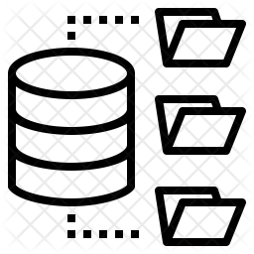

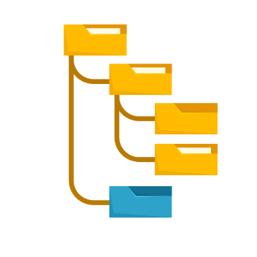
Maven workflow
pom.xml specifies the dependencies
mvn is a command-line tool that can fetch and update all dependencies
fetch
https://repo.maven.apache.org/maven2/
pom.xml
>mvn clean install

Slide 15
Maven build phases
Maven build process is divided into phases
Each phase has goals which correspond to individual commands such as jar cvf … and so on.
Key phases
compile: Compile the source code
test: Run unit tests
package: Package the compiled code (e.g., JAR/WAR)
install: Install the package into the local repository
deploy: Deploy the package to a remote repository
Demo
Notes:
Mvn clean
Mvn install
java -jar ./target/jedis_demo-1.0-SNAPSHOT.jar

Slide 16
Maven goals
Even though a build phase is responsible for a specific step in the build lifecycle, the manner in which it carries out those responsibilities may vary
Can declare goals bound to these phases
A goal is finer than a phase
mvn clean dependency:copy-dependencies package

Slide 17
Extending Maven with plugins
Plugins add goals to a build phase
These goals can be independently executed (mvn <goal>) or executed as part of the build phase
Plugins are also centrally hosted in the Maven repo
… and developers can develop their own plugins
… a more sophisticated Makefile or CMake system

Slide 18
Sample pom.xml
<?xml version="1.0" encoding="UTF-8"?>
<project xmlns="http://maven.apache.org/POM/4.0.0"
xmlns:xsi="http://www.w3.org/2001/XMLSchema-instance"
xsi:schemaLocation="http://maven.apache.org/POM/4.0.0 http://maven.apache.org/xsd/maven-4.0.0.xsd">
<modelVersion>4.0.0</modelVersion>
<groupId>com.ecs160</groupId>
<artifactId>annotations</artifactId>
<version>1.0-SNAPSHOT</version>
<dependencies>
<!-- Jedis Dependency -->
<dependency>
<groupId>redis.clients</groupId>
<artifactId>jedis</artifactId>
<version>4.3.1</version> <!-- Use the latest version -->
</dependency>
<dependency>
<groupId>com.google.code.gson</groupId>
<artifactId>gson</artifactId>
<version>2.10.1</version>
</dependency>
</dependencies>
</project>
Multiple dependencies can be
added using multiple <dependency>
tags

Slide 19
Installing maven
Java Development Kit
Install Java JDK from https://www.oracle.com/java/technologies/downloads/#java21
Maven
Install maven locally from https://maven.apache.org/install.html
Add mvn to the PATH variable
On Linux, add the location where you have unzipped mvn to the $PATH variable in ~/.bashrc
Add export $PATH=$PATH:<path where mvn exists> to ~/.bashrc
Run the command source ~/.bashrc in your shell
On Windows 11, open Settings -> System -> About -> Advanced System Settings -> Environment variables
Click “New” and add the <path where mvn exists>
Might have to reboot machine
Install the Maven plugin from VSCode marketplace

